Slide 1
AWS Elastic Kubernetes Service
Ecole by Capgemini AWS #2
July 2022

Slide 2

WHO AM I
Joffrey A.
Capgemini CIS | CHERBOURG
Cursus cloud AWS School by Capgemini
BAC +5 Manager of information systems and infrastructures
Today | Tech lead for Cloud Native Infrastructure tribe & Automation consultant | Multi-account Technical lead for internal CNI projects Hashicorp Terraform speaker for Master DevOps course AWS EKS speaker for School by Capgemini Automation consultant for Automation Développement Center team Animation for the CNI tribe
2022 Q1 | AWS Cloud course | School by Capgemini Project 1 : Audit AWS account for customer Aluminium Dunkerque Project 2 : Response to an RFP, move to CaaS with AWS EKS Project 3 : Case study on a re-architecting client suite at a merger of two companies Shadowing : Creation of a non-regression solution for the existing "Automation-stack" offer on AWS and Azure cloud environments Agility with SAFE, FinOps, Cybersecurity, IaC (Terraform & Ansible), Panorama of cloud computing Central Supelec course validation : Executive Certificate Architecte Cloud & DevOps
SKILLS
AWS
AZURE
Virtualization
Storage
Infra as Code
DevOps
Agility
2021 | Cloud Operations Engineer (COS : Cloud Operations Services)| Multi-account Development of a sandbox platform for CIS France (HTML, CSS, JS, PHP, REST) IaC (Terraform & Ansible) Microsoft Azure architecture Cloud computing (Azure & AWS)
CERTIFICATIONS
AWS : Practitioner, Architect associate, SysOps associate
AZURE : AZ900, AZ104
Hashicorp : Terraform associate
VMware : VCTA, VCP Data Center Virtualization & Desktop Management
Nutanix : NCP, NCP-MCI, NCAP
SAFE : Practitioner
2017-2020 | System Engineer infrastructures & virtualization | Synergie Orano Framatome Virtualization tech lead Automation referent for the team Build & Project
2013-2016 | Apprentice infrastructures & virtualization | Synergie Orano Framatome Processing of requests, changes & incidents, L2 Automation script for the team (PS1, SH, Python) Final dissertation on IT automation
SECTORS OF INTERVENTION
Cloud Architect
Cloud Native
DevOps

Slide 3

YOUR TURN

Slide 4
agenda

Slide 5

presentation

Slide 6
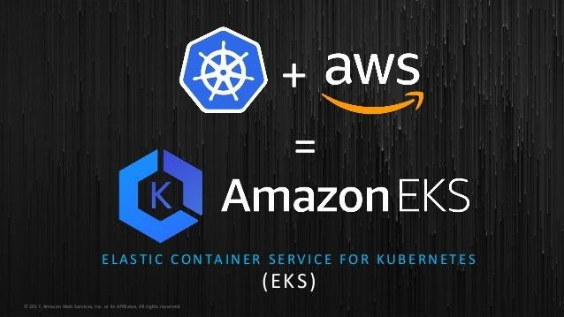
Elastic Kubernetes services
What is it ?
Amazon EKS is a managed service for running Kubernetes on AWS and on-premises
Amazon EKS can run on Amazon EC2 or AWS Fargate (Worker less)
Integrates with Application Load Balancers, AWS IAM for RBAC and Amazon VPC
EKS runs the Kubernetes control plane across three AZs to ensure high availability, and automatically detects and replaces unhealthy control plane nodes..

Slide 7
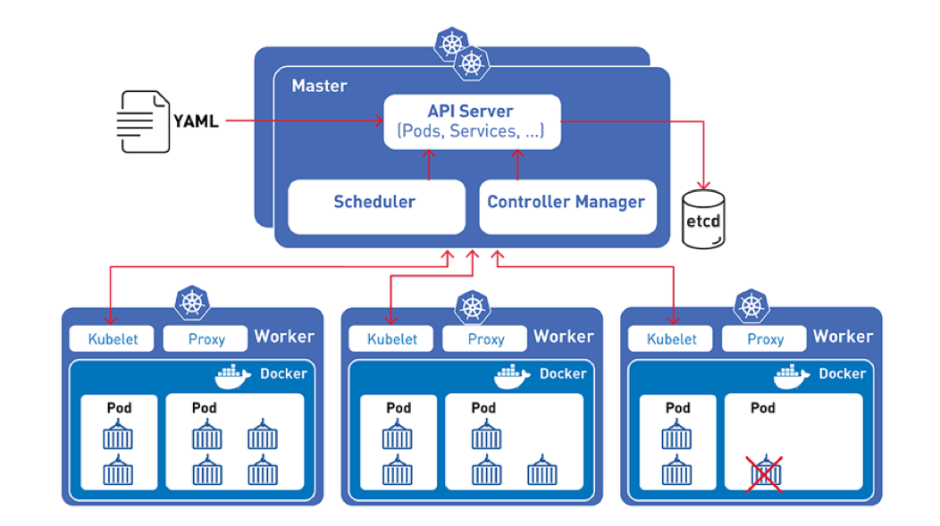
K8S “vanilla” architecture

Slide 8
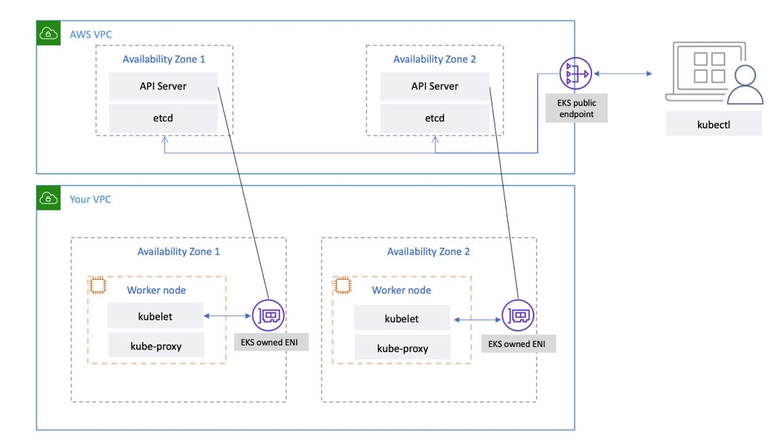
AWS EKS ARCHITECTURE

Slide 9
Advantage of AWS EKS
You don’t have to install, operate, and maintain your Kubernetes control plane.
EKS allows you to easily run tooling and plugins developed by the Kubernetes open-source community.
EKS automates load distribution and parallel processing.
EKS uses VPC networking.
Any application running on EKS is compatible with one running in your existing Kubernetes environment. You can migrate to EKS without applying any changes to the code.
Supports EC2 spot instances using managed node groups that follow spot best practices and allow some pretty great cost savings.

Slide 10
EKS Models
EKS Fargate
This model has been designed to give the possibility to concentrate only on workload, pods configurations, and application logic, without worrying about the infrastructure management, availability, fault tolerance, scaling, and patching of host machines. Therefore the , control pane and worker nodes are managed by AWS.
Scalability AWS is responsible for managing the scaling of the worker nodes in the cluster, so you don’t need to worry about scalability
Hardware Each pod has dedicated resources and can be sized independently to maximize resource utilization
Managed node
This model gives developers the freedom to manage not only the workload, but also the worker nodes. Worker nodes consist of a group of EC2 instances. However, the control pane is always managed by AWS
Scalability The customer is responsible for managing the scalability of the worker nodes
Hardware Pods share CPU, memory, storage, and network resources with other pods
Cost - Fargate Case: 15 pods, using 2vCPU, 16 GB memory each (3 hours a day and 24 hours)
Cost - Managed Node Case: 15 nodes, using 2vCPU, 16 GB memory each (3 hours a day and 24 hours)
($0.0111/hour x 3 hours x 30 days) x 15 = $14.9/months
($0.0111/hour x 24 hours x 30 days) x 15 = $119.88//months
Managed Node EC2 Cost (15 nodes m5.large)
Monthly CPU charges Fargate
Total vCPU charges = # of Pods x # vCPUs x price per CPU-second x CPU duration per day (seconds) x # of day
15 pods x (2vCPU x $0.04048/(60x60) seconds) x 10800 seconds x 30 days = $109.29 /Month
15 pods x (2vCPU x 0.000011244) x 43200 seconds x 30 days = $437.16 /Month

Slide 11
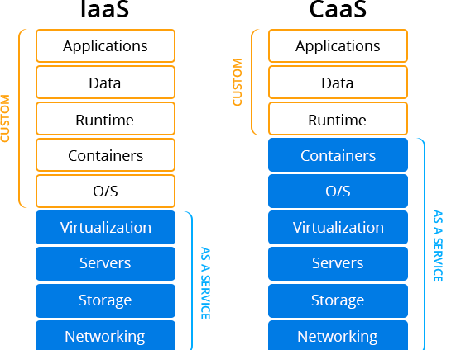
Managed node
Managed (EKS) nodes groups | Self managed nodes
With the EKS-managed node groups, EKS automatically creates and updates data-plane nodes. Users need to click only a couple of buttons on the web console to add new nodes and update the OS or Kubernetes versions. | With the self-managed nodes, users need to create and manage nodes with manual configuration or via the AWS CloudFormation templates provided by EKS. When the EC2 VMs are up and running, they join the Kubernetes control plane. Then, the Kubernetes control plane assigns pods to the nodes and runs containers. In addition, users need to handle the updating of the OS and Kubernetes version of the data-plane nodes.

Slide 12
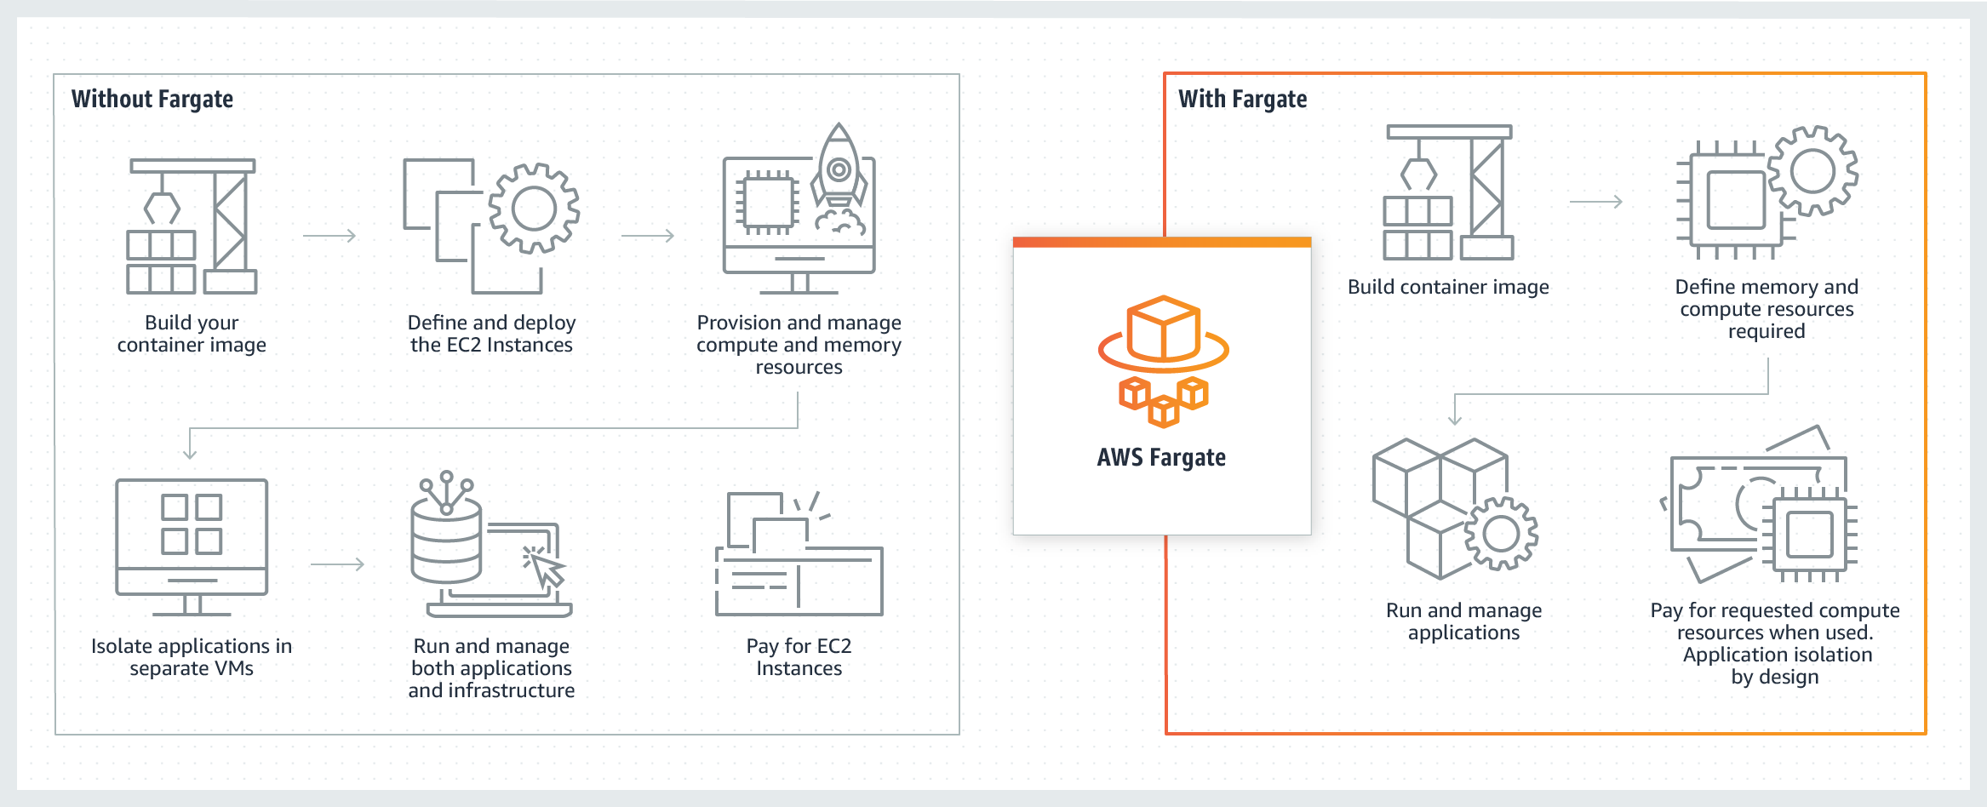
Fargate
Serverless & pay-as-you-go compute engine that lets you focus on building applications without managing servers

Slide 13
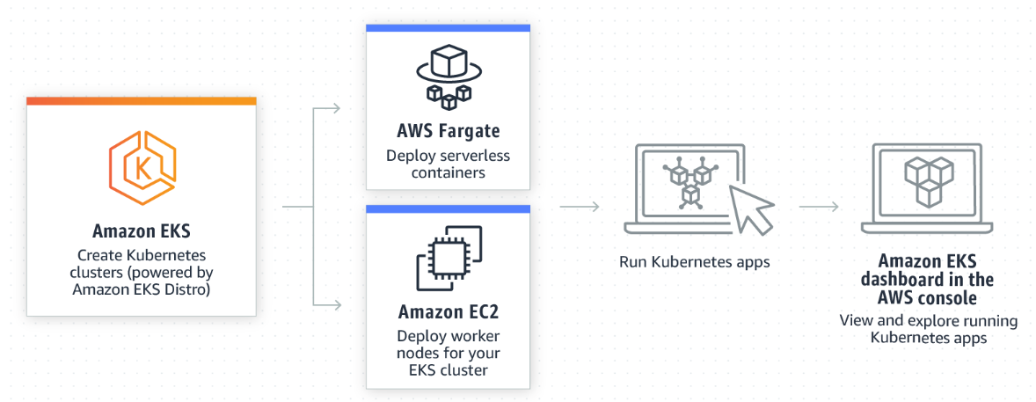
Make your choice

Slide 14

tools
EKSCTL
Command line tool for creating and managing Kubernetes clusters on Amazon EKS, provides the fastest and easiest way to create a new cluster, add nodes or fargate profile by the use of Cloudformation template
KUBECTL
Command line tool that you use to communicate with the Kubernetes API server, You must use a kubectl version that is within one minor version difference of your Amazon EKS cluster control plane.
AWS CLI
The AWS Command Line Interface (AWS CLI) is a unified tool to manage your AWS services. With just one tool to download and configure, you can control multiple AWS services from the command line and automate them through scripts
Terraform
Official providers → AWS, Kubernetes, Helm

Slide 15
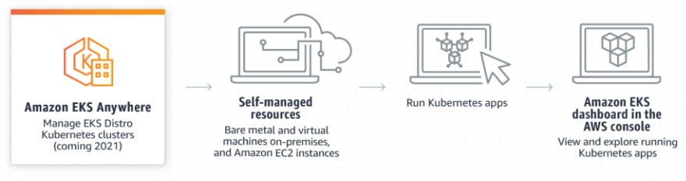
EKS anywhere
Run your EKS cluster on prem’
Support on bare metal servers or using VMware vSphere
Can work in Disconnected environment

Slide 16
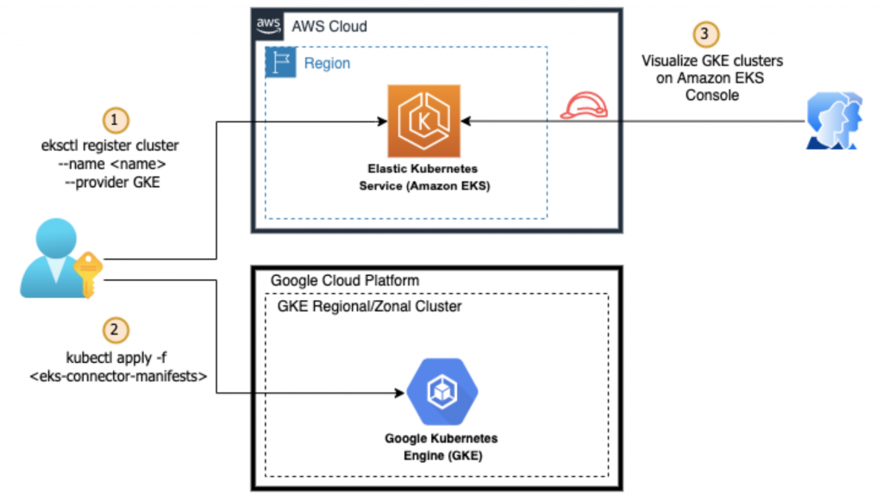
EKS Connector
You can use Amazon EKS Connector to register and connect any conformant Kubernetes cluster to AWS and visualize it in the Amazon EKS console
On-premises Kubernetes clusters
Self-managed clusters that are running on Amazon EC2
Managed clusters from other cloud providers

Slide 17
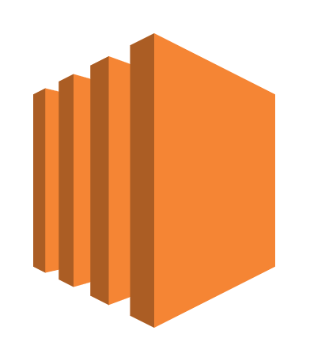

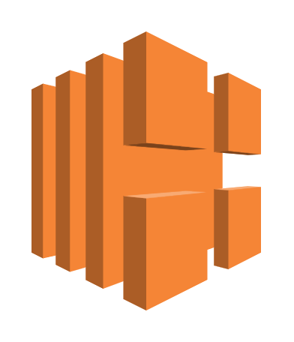
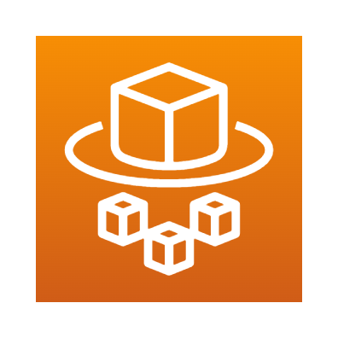
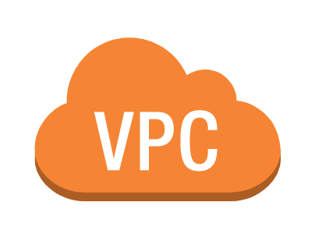
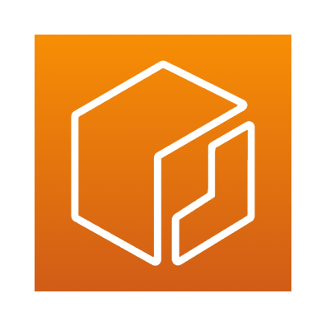
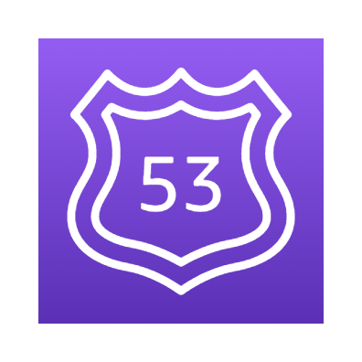

Aws services integration
EC2
AWS Identity and Access Management (IAM)
Elastic Load Balancing
AWS Fargate
Amazon Virtual Private Cloud
Amazon Elastic Container Registry (Amazon ECR)
Route 53
CloudWatch
Notes:
eventbridge, cloudtrail…

Slide 18
Demonstration

Slide 19
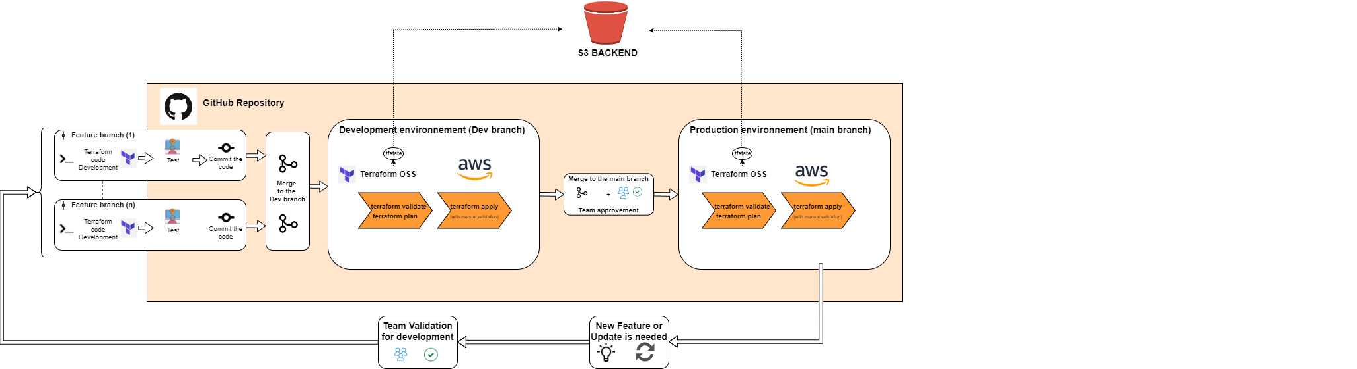
Pipeline ci/CD

Slide 20

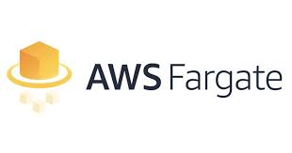

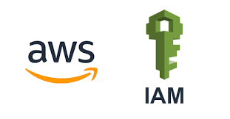
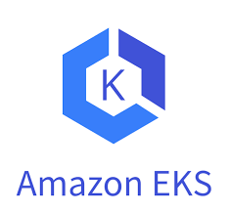

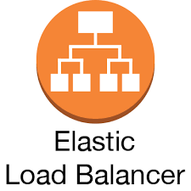
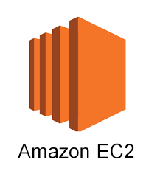
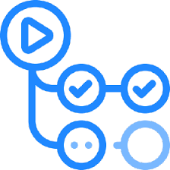

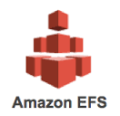
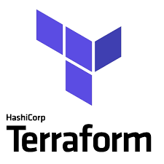
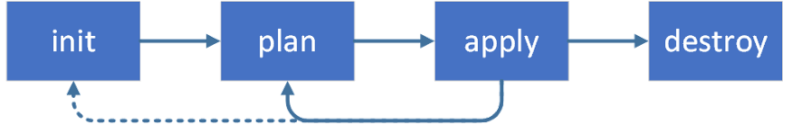
Architecture

Slide 21
practice

Slide 22
Objectif
Dans ce lab vous allez :
Déployer les ressources nécessaires à la création d’un cluster EKS (VPC, subnets, IGW, NGW, route table…)
Configurer une instance EC2 et installer les outils pour l’administration d’un cluster EKS et la réalisation du TP :
Kubectl : Outil générique d’administration des clusters K8S
Eksctl : Outil propriétaire d’AWS pour l’administration des clusters EKS
AWS CLI : Outil CLI d’administration AWS, y compris EKS (complémentaire à eksctl)
GIT : afin de récupérer les manifest K8S (yaml) et les appliquer sur votre cluster EKS.
Déployer un cluster EKS avec 2 worker nodes.
Déployer une application NGINX containérisée.
Upgrade un cluster EKS & configurer un fargate profile

Slide 23
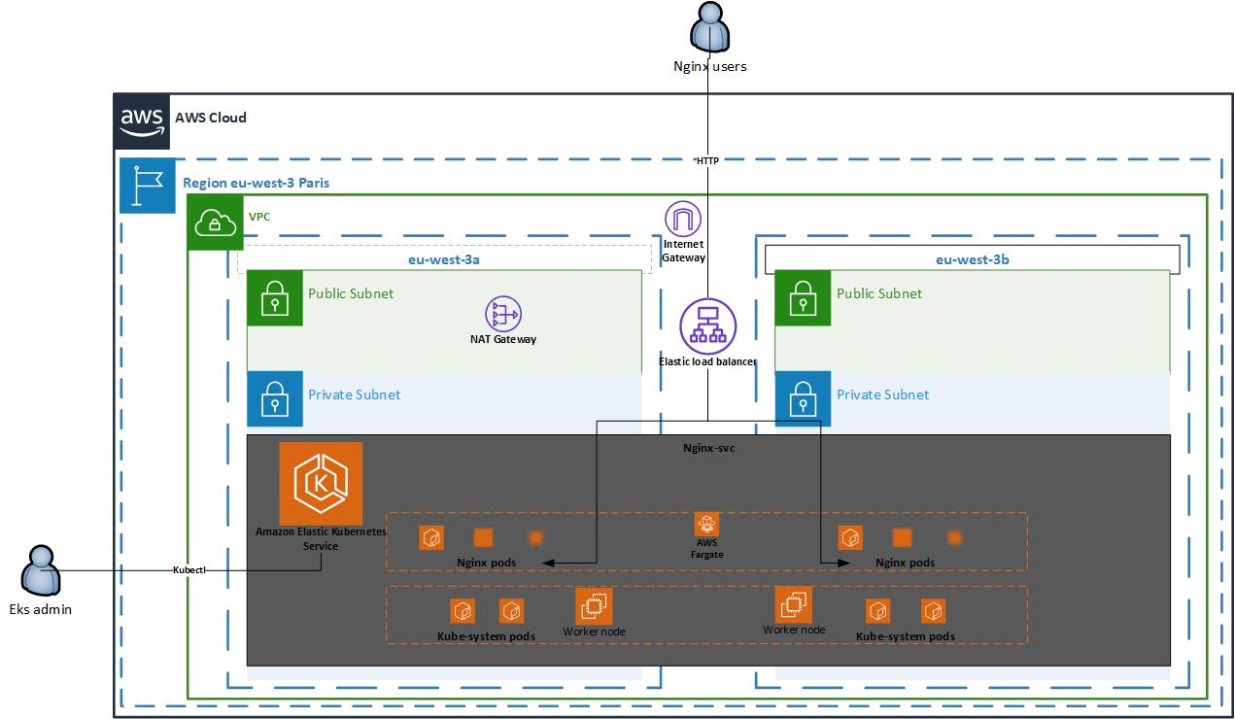
HLD

Slide 24
Comments & feedback

Slide 25
GET THE FUTURE YOU WANT
capgemini.com

Slide 26
About Capgemini
Capgemini is a global leader in partnering with companies to transform and manage their business by harnessing the power of technology. The Group is guided everyday by its purpose of unleashing human energy through technology for an inclusive and sustainable future. It is a responsible and diverse organization of over 325,000 team members more than 50 countries. With its strong 55-year heritage and deep industry expertise, Capgemini is trusted by its clients to address the entire breadth of their business needs, from strategy and design to operations, fueled by the fast evolving and innovative world of cloud, data, AI, connectivity, software, digital engineering and platforms. The Group reported in 2021 global revenues of €18 billion.
Get The Future You Want | www.capgemini.com

